Slide 1
Software Product Line
张严辞

Slide 2
Motivation
Software architecture represents significant investment of time effort by senior talent
Products resemble each other more than they differ
Adobe Photoshop CS and Adobe Photoshop Elements
How to maximize return on the investment?

Slide 3
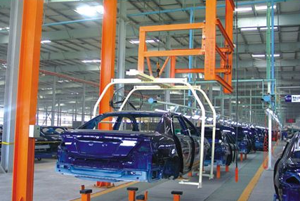

What is Product Line?
Nothing new in manufacturing
Early 1800s: Eli Whitney’s use of interchangeable parts to build rifles
Car industry: various types of cars are produced by same product lines

Slide 4
Definition
A set of software-intensive systems sharing a common, managed set of features that satisfy the specific needs of a particular market segment or mission and that are developed from a common set of core assets in a prescribed way

Slide 5
Advantages
Each re-usable asset saved in a core asset base can be applied to more than one system because re-using it will be cheaper than re-inventing it
Improves cost, quality, and time to market

Slide 6
Core Assets
Designs
Documentation
User manuals
Project management artifacts (budgets and schedules)
Test plans and test case

Slide 7
Building Process
Once core assets are in place, system building becomes a matter of
Accessing appropriate assets in core asset base
Exercising variation points to configure them as required for system being build
Assembling that system
Class discussion: How to handle variation points?

